Slide 1
Section 3.1
Polynomial Functions
© Copyright all rights reserved to Homework depot: www.BCMath.ca

Slide 2

What is a Polynomial Function?
A function that contains powers of “x” in the form of:
A,B,C,D,…E are Coefficients & must be real numbers
The exponents “n”, “n-1”…. have to be whole numbers
Can’t have “x” in the denominator, exponent, or “x” as a radical
Ex#) Indicate which of the following are NOT polynomials & explain why:
YES
YES
$$yes, \left|x2\right|=x2$$
NO, can’t root the variable
NO, this is a rational function
Yes, b/c a constant can be a polynomial with a dress of zero
NO, b/c abs value fc are not polynomials
b/c ‘x’ is in denominator
NO, b/c “x” is in exponent

Slide 3
Common Terms for Polynomial:
Degree of a Polynomial:
The largest exponent for the variable
The degree can be used to determine how many times a polynomial function will “turn”
Leading Coefficient:
The coefficient of the term with the largest exponent
The leading coefficient can be used to determine where the graph begins on the left side – (top/bottom)
Negative (vertical reflection)

Slide 4
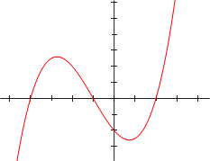
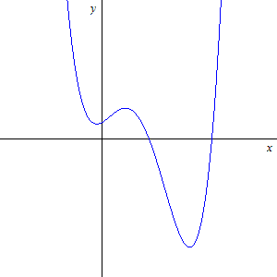
Definition & Terms
The degree of a polynomial is the largest exponent of a variable in the polynomial
  The degree indicates the maximum number of roots a polynomial can have and how many times the graph changes directions
Degree:
3
Degree:
4
Degree:
2
Cubic function
Quartic function
Quadratic function
LC: 2
LC: 5
LC: 8
Constant: -2
Constant: 4
Constant: 8
Y-int: (0,-2)
Y-int: (0,4)
Y-int: (0,8)
Leading coefficient: the coefficient of the term with the largest degree
  Leading Coeff (+): Graph opens up, (–’ve): Graph opens down, or flipped upside down
Constant Term: Term with no variables [Y-intercept]

Slide 5
General Concepts:
EVEN Degree functions
opens up (left side: Top)
ODD Degree functions usually begin at the left side from the bottom
If the leading coefficient is NEGATIVE, the graph will have a vertical reflection (Up side down)

Slide 6
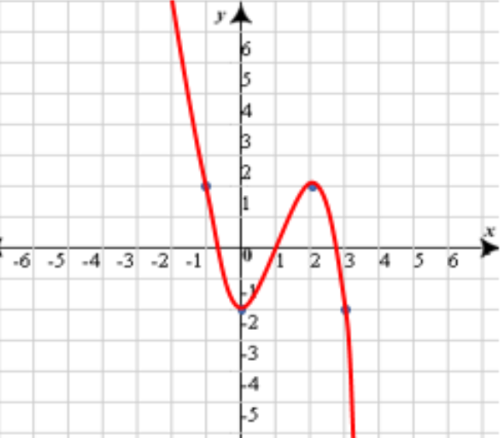
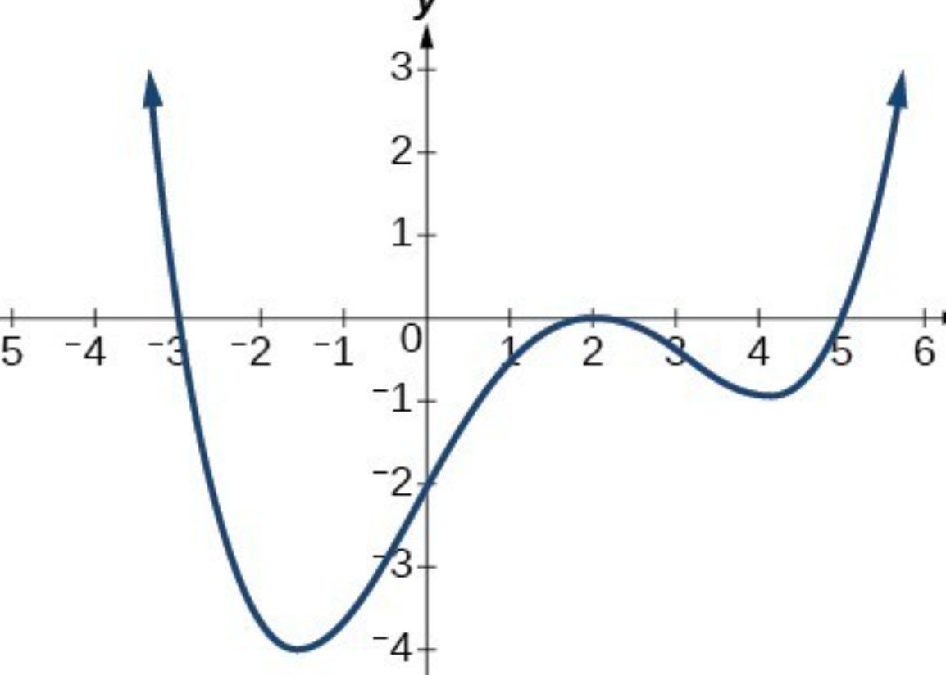
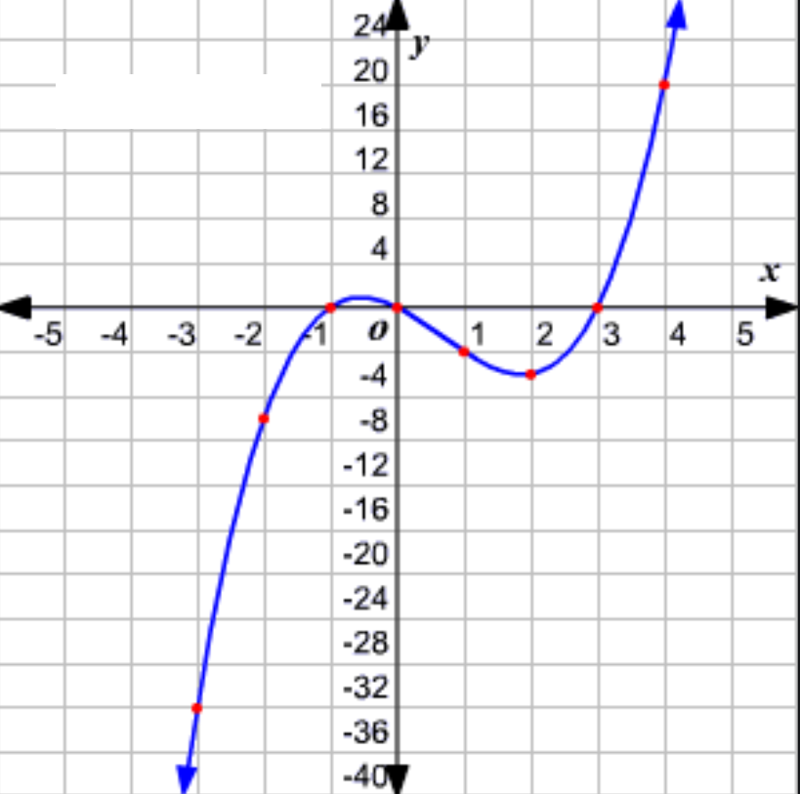
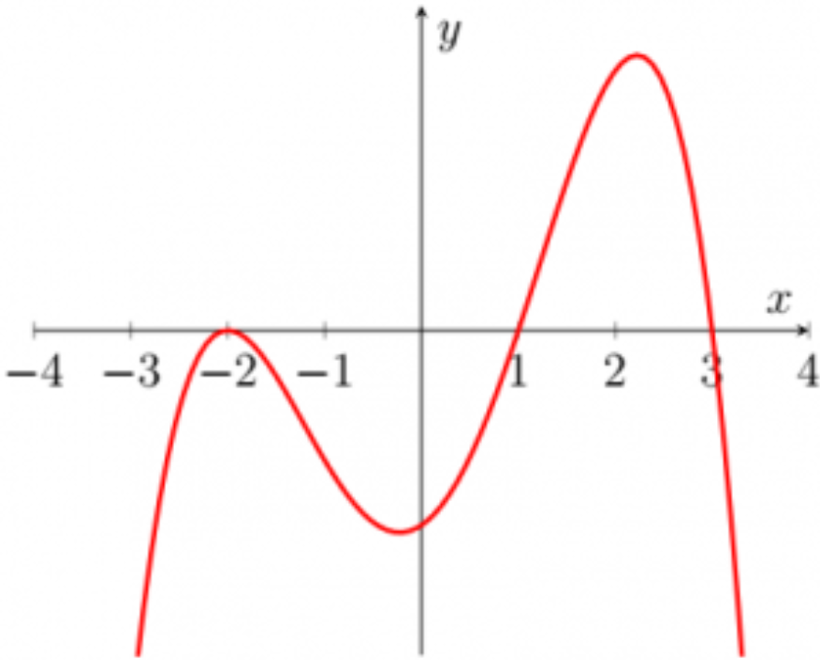
Ex: Indicate the degree, LC, constant term for each function below. Then state what function it is (ie: Cubic, quartic,….) and match it with the corresponding graph below

Slide 7
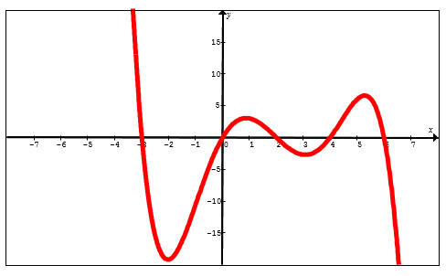
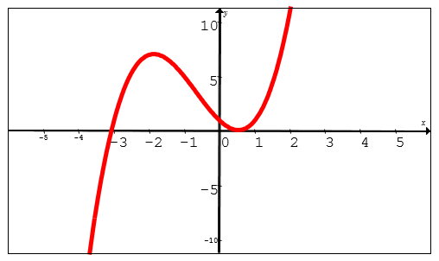
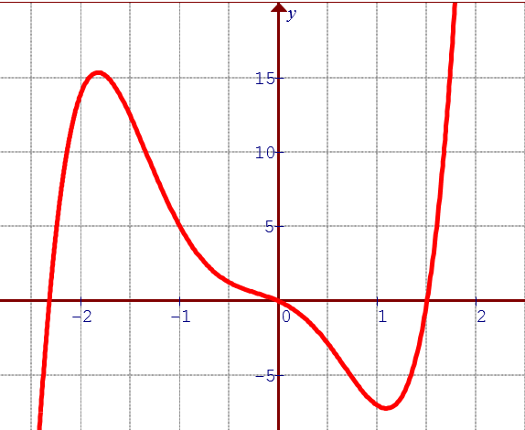
Ex: Match the graph with the correct function:

Slide 8
Reading a Function in Factored Form:
A polynomial function in General form:
A polynomial function in Factored Form:

Slide 9
Graphing a polynomial function in factored form:
Find the roots (x-intercept) and look for repeated roots
Find the Y-intercept: where the graph crosses the y-axis
Find the Degree: Count the number of X’s in the function OR get the exponents of “X’s”
Find the lead coefficient: tells you which way the graph opens
When 2 roots are the same, it’s called a “Double Root”.
Instead of crossing the x-axis, it “bounces” off the x-axis.
When 3 roots are the same, it’s called a “Triple Root”

Slide 10
What happens with Repeated Roots:
y
8
6
4
2
0
x
-5
-4
-3
-2
-1
0
1
2
-2
-4
-6
-8

Slide 11
Ex: Indicate the number of roots, the value of the roots, the degree, and leading coefficient for each of the following. Then graph each function separately:

Slide 12
Ex: Given the equation:
Graph and find the following
y
y
6
6
4
4
2
2
x
x
-4
-4
-3
-3
-2
-2
-1
-1
0
0
1
1
2
2
3
3
4
4
-2
-2
-4
-4
-6
-6

Slide 13
Ex: Given the equation:
Find the following:

Slide 14
Ex: Given the equation:
Graph and find the following
y
y
4
4
2
2
x
x
-3.5
-3
-2.5
-2
-1.5
-1
-0.5
0
0.5
1
1.5
2
2.5
3
3.5
-3.5
-3
-2.5
-2
-1.5
-1
-0.5
0
0.5
1
1.5
2
2.5
3
3.5
-2
-2
-4
-4

Slide 15
Ex: Given the equation:
Graph and find the following
y
x
-2
-1
0
1
-5
-10
-15

Slide 16
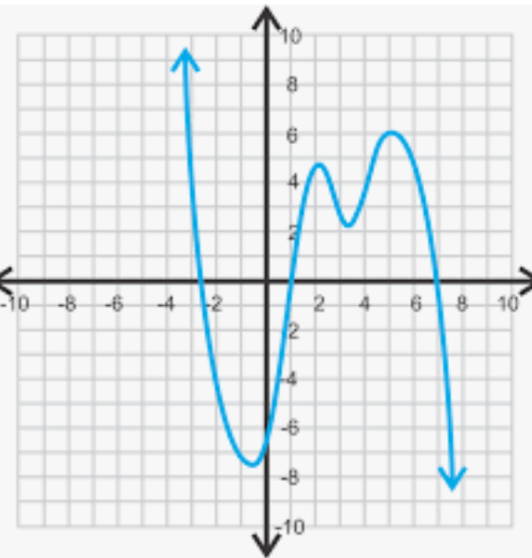
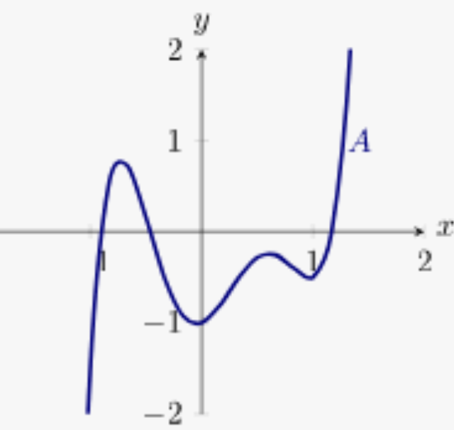
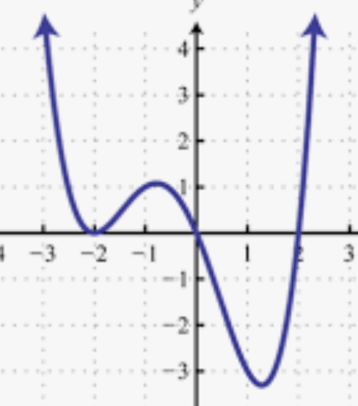
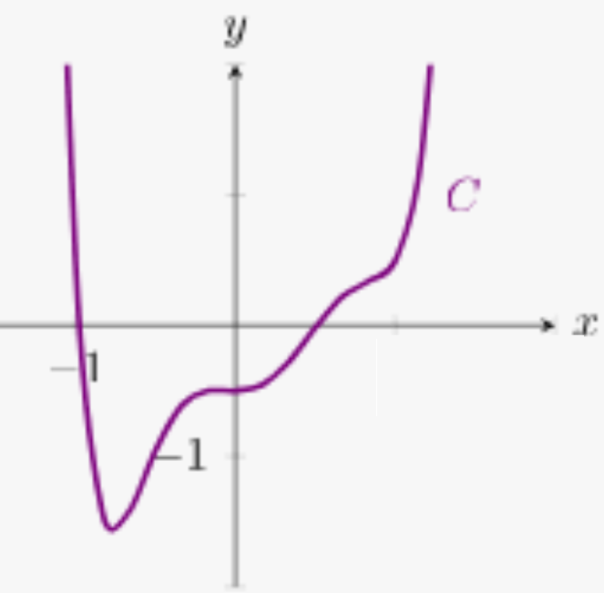
Match each graph with the corresponding Equation:

Slide 17
Ex: Determine the equation of a function with roots: -1, 1, 3 and y-intercept of -6.
Plug the roots into the equation in factored form
Plug the coordinates of the point into the equation to solve for “a”

Slide 18
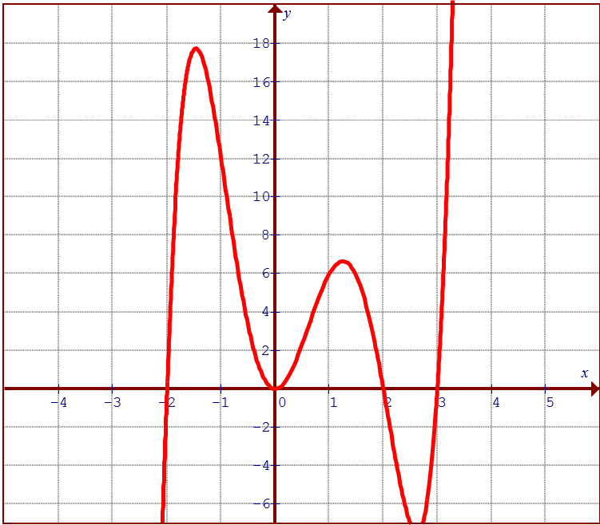
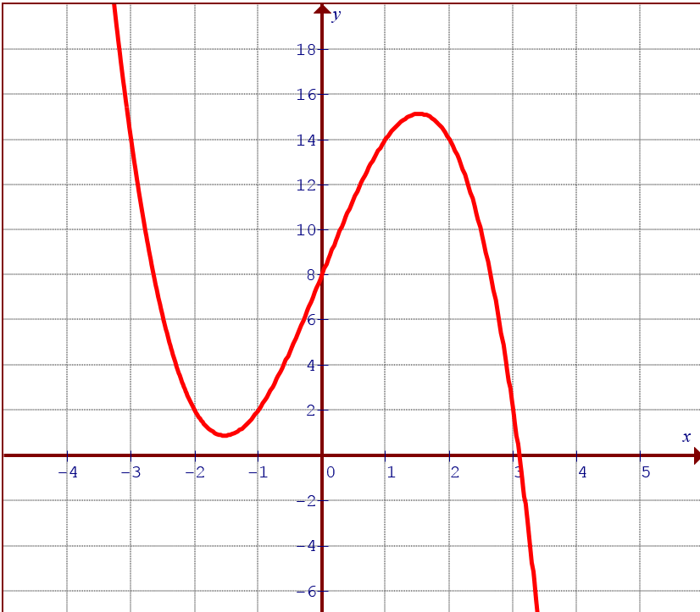
Practice: Derive the Equation for each polynomial

Slide 19
Challenge: A cubic function P(x) has coefficients that are integers from 1 to 9. If P(1) = 10, then how many possible functions are there?

Slide 20
Finite Difference:
When given a table of values for a polynomial function, you can get the equation by using a method called “Finite Difference”
Using the difference of each row, we can determine what degree this polynomial is:
Since all the terms are equal in the 2nd order, we know that the degree of the polynomial will be 2
Since all the terms are equal in the 3rd order, we know that the degree of the polynomial will be 3

Slide 21
Finding the Coefficients from polynomial:
After determining the degree of a polynomial, there are 3 ways to find the coefficients
First Method: Basic Algebra

Slide 23
2nd Method: The Matrix!
The matrix method is the same as using “linear algebra”
We will demonstrate by using the Ti-83
Press 2nd Math(matrix) on Ti-83

